Slide 1
Advanced Topics - Web Dev: Ruby on Rails
Team members: Shaira Sharapova, Michael Pierce

Slide 2
TABLE OF CONTENTS
01
02
03
04
Install Ruby on Rails
History of Ruby
05
Ruby Fundamentals
Structure of Ruby on Rails Project
06
Activity Time: Ruby exercises in playground
Demo
07
Activity Time: Ruby on Rails exercises
08
Ruby on Rails Revolution

Slide 3
01
History of Ruby
“Ruby is simple in appearance, but is very complex inside, just like our human body.”
- Yukihiro “Matz” Matsumoto

Slide 4
CREATION
Created by Yukihiro “Matz” Matsumoto in 1993, released in 1995
Blended parts of his favourite languages
Perl, Smalltalk, Eiffel, Ada and Lisp
Balanced functional programming with imperative programming
“Trying to make Ruby natural, not simple”
Notes:
Ruby was created by Yukihiro “Matz” Matsumoto in 1993, and released in 1995. Matsumoto blended parts of his favorite languages - Perl, Smalltalk, Eiffel, Ada, and Lisp to create a new language with a unique blend of features.
One of the notable features of Ruby is its balanced approach to programming paradigms. It blends functional programming with imperative programming. To understand this better, let me briefly define these programming paradigms.
Functional programming is a programming paradigm that treats computation as the evaluation of mathematical functions and avoids changing-state and mutable data. In simple terms, it emphasizes the use of functions and the immutability of data.
On the other hand, imperative programming is a programming paradigm that gives a set of commands that change the program's state. It emphasizes the use of statements that change a program's state, usually using variables.
Ruby balances these two paradigms, making it a powerful and versatile language. The language is designed to be natural and readable, allowing developers to write code that is both elegant and functional. As Matsumoto once said, he aimed to make Ruby "natural, not simple."

Slide 5
FEATURES
Object Oriented
Mixins
Each and every value is an object
While Ruby only supports single inheritance, it also supports modules using “include”
Duck Typing
Simplicity
When a method is called on an object, Ruby looks for the name irrespective of the object type.
Syntax and naming conventions are made to be human-readable.
Example: methods that return a Boolean end in a ?

Slide 6
GROWTH!
Since release, Ruby has drawn a devoted community worldwide.
Gained mass-acceptance in 2004-2006 with the launch of Ruby on Rails
Ranked in the top 10 or top 20 most popular programming language, depending on the survey
Ruby is free to use – not just free of charge, but free to copy, modify and distribute
Notes:
Since its release, Ruby has attracted a devoted community worldwide. In 2004, the launch of Ruby on Rails brought Ruby into the mainstream, and it has continued to gain acceptance ever since. In fact, depending on the survey, Ruby is ranked in the top 10 or top 20 most popular programming languages.
One of the most attractive features of Ruby is that it is an open-source language. This means that it is free to use, not just free of charge, but free to copy, modify, and distribute. Anyone can access and use the Ruby source code, modify it, and contribute to its development. This has led to a vibrant and active community of Ruby developers worldwide.

Slide 7
RUBY IN 2023
#16 in TIOBE programming popularity survey
Rails is still popular, but lacks “latest innovation” status
Rails still used by large companies like Shopify and Github
Twitter started with Rails, but moved to Scala for better scalability
Still a high demand for Ruby and Ruby on Rails developers
Notes:
According to the TIOBE programming popularity survey, Ruby is ranked #16, making it a widely-used language in the industry. Ruby on Rails is still popular and used by large companies like Shopify and Github.
While Ruby on Rails may have lost its "latest innovation" status, it remains a robust and reliable framework that powers many successful web applications. In fact, there is still a high demand for Ruby and Ruby on Rails developers in the industry.
Even Twitter, which initially started with Rails, eventually moved to Scala for better scalability. However, this does not diminish the capabilities of Ruby on Rails. It simply shows that Scala is better suited for building large-scale systems with highly distributed computing requirements. Scalability is one of Ruby on Rails weaknesses.

Slide 8
02
RUBY FUNDAMENTALS
“I believe that the purpose of life is, at least in part, to be happy. Based on this belief, Ruby is designed to make programming not only easy but also fun. It allows you to concentrate on the creative side of programming, with less stress.”
- Yukihiro Matsumoto

Slide 9
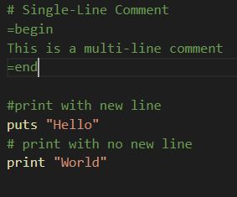
COMMENTS AND PRINT
“puts” will print and add a new line
“print” will print without a new line
# for single line comment
=begin and =end to wrap multi-line comments

Slide 10
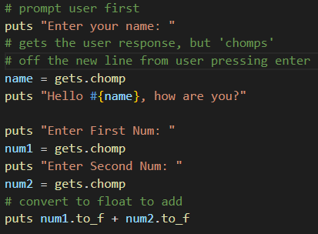
USER INPUT
“gets” is similar to Console.Readline
“gets” returns a new line character, use gets.chomp to remove new line

Slide 11
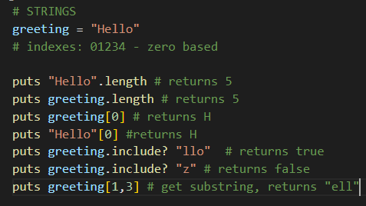
STRINGS
Everything in Ruby, including strings, are an object
Access length with .length
Access individual characters using array notation
Use .include? to check if a string contains given characters

Slide 12
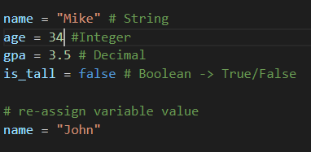
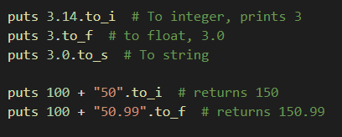
VARIABLES
ASSIGNMENT
Assign using = sign
Integers, Strings and Booleans are not value types, they are objects
These objects have methods to convert to other types
CONVERSION

Slide 13
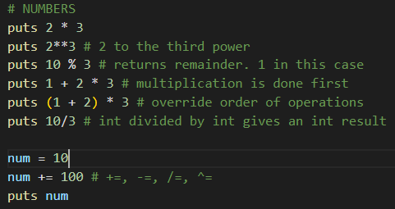
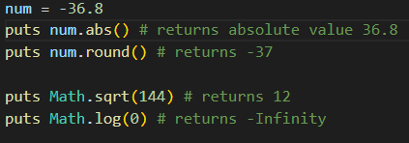
NUMBERS AND ARITHMETIC
Typical math operators operate as expected in Ruby
+, -, *, /, %
** - to the power of
Assignment operators such as +=, -=, /=, *=, %=
Since numbers are objects, they have methods like .abs and .round()
Math class also has useful math functions

Slide 14
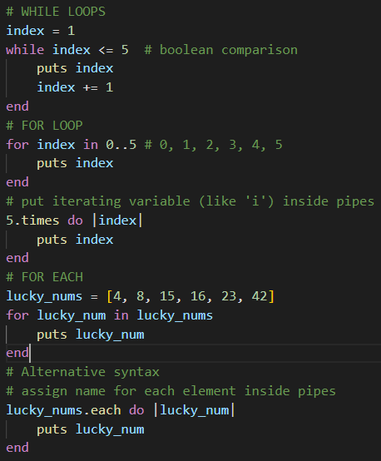
LOOPS
Ruby does not use bracket { } notation,
“for” keyword can iterate over an array of values
“for” with index can be accomplished by specifying iterating variable
Alternative syntax for forEach makes code more readable

Slide 15
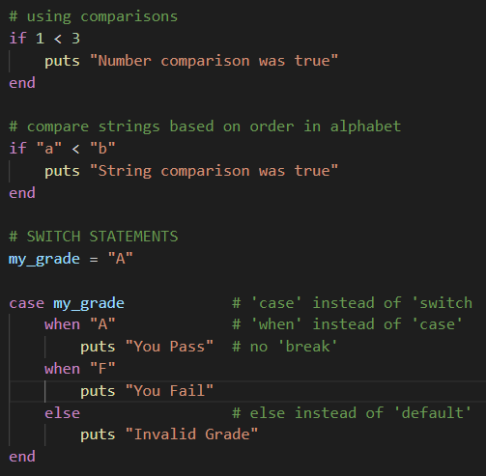
CONDITIONALS
No parenthesis ( )
Compare using Boolean expressions, including alphabet letters
Switch statements have different syntax than other languages

Slide 16
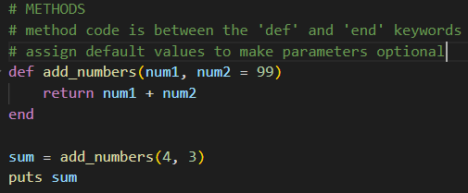
METHODS
Method code is between ‘def’ and ‘end’ keywords
Pass parameters through parenthesis
Values can have default values, to make them optional

Slide 17
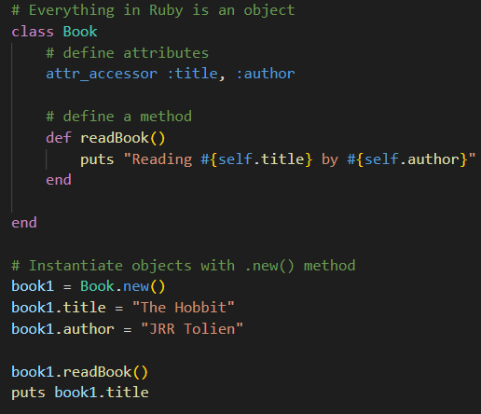
CLASSES
Classes can have properties(Attributes) and methods
Instantiate with .new() method
Access attributes and methods using dot notation

Slide 18
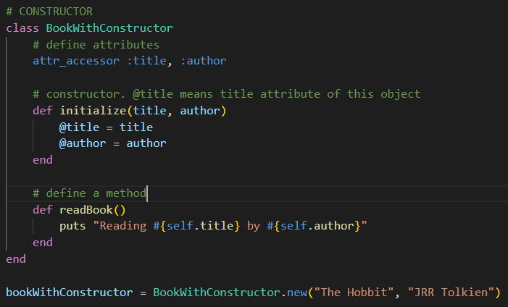
CLASSES
Constructors can be created using the initialize method
Use @ to refer to ‘this’ object (@title)
Pass parameters to the ‘new’ method

Slide 19
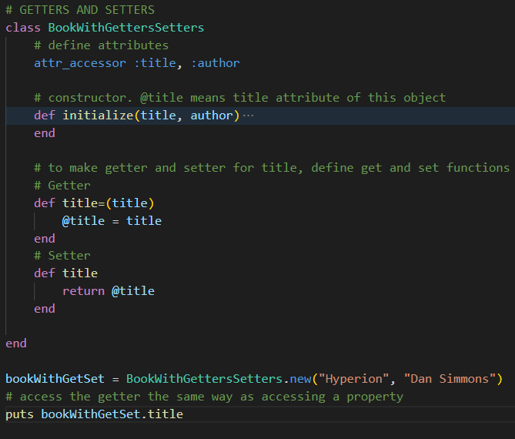
CLASSES
Ruby supports Getters and Setters
Define get and set methods inside the class
Access the getter and setter the same way as accessing a property

Slide 20
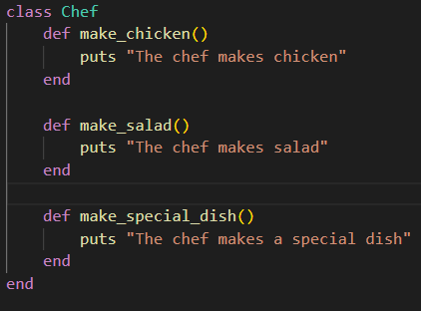
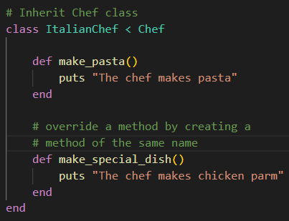
INHERITANCE
Classes can inherit from other classes using >
To override a parent method, simply create a method with the same name

Slide 21
03
RUBY EXERCISE
“Ruby is super easy to read (syntactically) and write. You don’t have to know Ruby to figure out what this does:
5.times { print “Hi! It’s the year #{Time.now.year}” }”
- Aaron Hill, Quora

Slide 22
ONLINE PLAYGROUND https://runrb.io/
Code along with my Ruby language demo
Complete Ruby practice exercise

Slide 23
04
Ruby on Rails Revolution
What Is Rails?
“A web-application framework that
includes everything needed to create
database-backed web applications
according to the Model-View-Controller (MVC) pattern.”
rubyonrails.org

Slide 24
Ruby on Rails
Ruby on Rails, also known as Rails, is a popular open-source web development framework that has taken the software industry by storm. Since its initial release in 2004, Rails has experienced a revolution that has transformed the way web applications are developed and deployed.
Before Rails, web development was a tedious and time-consuming process that involved writing lots of boilerplate code to handle common tasks like managing databases and handling HTTP requests. This often resulted in slow development cycles and made it difficult to scale applications.

Slide 25
Ruby on Rails now
Ruby on Rails has been in use for over 15 years, and Version 7 was released in December of 2021.
Version 7 contains mostly new features and improvements, and there are few breaking changes from older versions.
The features a beginner uses have been pretty stable for many years.

Slide 26
Key factors that contributed to the success of Rails
Focus on developer productivity
Vibrant community that grew around it
Rails aimed to make web development more accessible to developers of all skill levels, by providing a consistent and intuitive framework that made it easier to learn and get started with.
Rails quickly gained a following of enthusiastic developers who contributed to the framework, built plugins and extensions, and created a vast ecosystem of tools and resources.

Slide 27
05
Install Ruby on Rails

Slide 28

Step 1: Install Ruby
Download an installation package from rubyinstaller.org. Follow the download link,
and run the resulting installer.

Slide 29

Step 2: Install Rails
Install Rails − With Rubygems loaded, you can install all of Rails and its dependencies using the following command through the command line −

Slide 30
Step 3: Check Rails Version
Use the following command to check the rails version.er Windows.

Slide 31
Congratulations! You are now on Rails over Windows.
er Windows.

Slide 32
06
Structure of Ruby on Rails Project

Slide 33
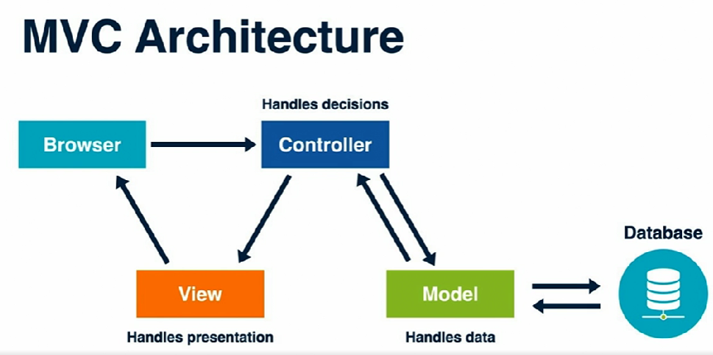
Rail MVC Architecture

Slide 34
Rail MVC Architecture
Ruby on Rails uses an MVC architecture. It's fundamental to how the framework is structured and is designed to help us not repeat ourselves. The M stands for model, the V stands for view, and the C stands for controller.
The MVC web architecture breaks up single page by function. The browser communicates with the controller. The controller processes and responds to user events, such as clicking on links and submitting forms. The controller makes decisions based on the request and controls what happens in response. If the controller needs to interact with the database, it will talk to our models.
The models are objects for storing and working with data. The model will return its results back to the controller. The controller may go back to the model several times while making its decisions and constructing a response. And then finally, the controller will send its results to the view, the presentation layer. It's what the user sees and interacts with. The webpages, HTML, CSS, and JavaScript. Decision code goes in the controller. Data code goes in the model. And presentation code goes in the view.
Notes:
Ruby was created by Yukihiro “Matz” Matsumoto in 1993, and released in 1995. Matsumoto blended parts of his favorite languages - Perl, Smalltalk, Eiffel, Ada, and Lisp to create a new language with a unique blend of features.
One of the notable features of Ruby is its balanced approach to programming paradigms. It blends functional programming with imperative programming. To understand this better, let me briefly define these programming paradigms.
Functional programming is a programming paradigm that treats computation as the evaluation of mathematical functions and avoids changing-state and mutable data. In simple terms, it emphasizes the use of functions and the immutability of data.
On the other hand, imperative programming is a programming paradigm that gives a set of commands that change the program's state. It emphasizes the use of statements that change a program's state, usually using variables.
Ruby balances these two paradigms, making it a powerful and versatile language. The language is designed to be natural and readable, allowing developers to write code that is both elegant and functional. As Matsumoto once said, he aimed to make Ruby "natural, not simple."

Slide 35
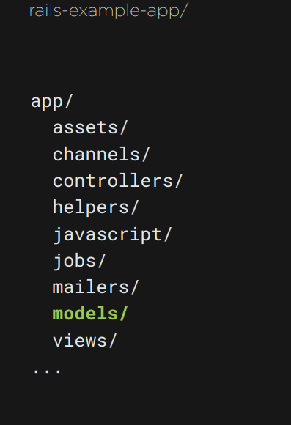
Rails Folder Structure

Slide 36
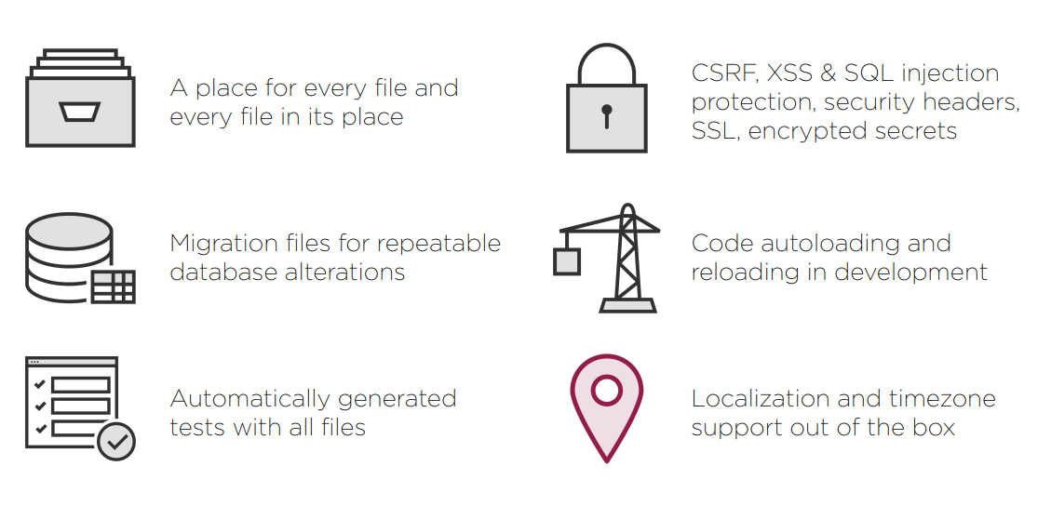
Rails Conventions & Defaults

Slide 37

Ruby on Rails Companies
Shopify is one of the most successful companies using Ruby on Rails globally. The company has been scaling massively within the framework and boasts about being able to address 80,000 requests per second.

Slide 38

Ruby on Rails Companies
Github is now used by over 1.8 million companies, software development businesses, and startups.
From a technological viewpoint, Ruby on Rails accounts for nearly all of GitHub’s code. As of August 2019, the Rails 6.0 version of GitHub was launched.

Slide 39
07
RUBY ON RAILS DEMO
Planter

Slide 40
Summary
1) rails new <application_name>
• create application & install dependencies
2) rails generate scaffold <name> <attribute>
• create a full model-to-views prototype
3) rails server
• start local server and display request logs
4) rails db:migrate
• run any pending database migration
5) rails routes
• lists all routes & route helper methods
6) rails help
• find more rails commands

Slide 41
08
RUBY ON RAILS EXERCISE

Slide 42
REFERENCES
Ruby on Rails 6: Getting Started. Author:
Anthony Alampi. Released: 19 Oct 2021.
Publisher: Pluralsight
Ruby on Rails: The Big Picture. Author:
Olivier Lacan. Released: 22 Jan 2021. Publisher:
Pluralsight
Fireship (Director). (2022, January 31). Ruby in 100 Seconds. https://www.youtube.com/watch?v=UYm0kfnRTJk
Grullon, M. (2018, March 27). Blurred Lines: Is Ruby an interpreted language and what does that even mean? Medium. https://medium.com/@astermanuelg/blurred-lines-is-ruby-an-interpreted-language-2d3d6bca3d37
Ruby on Rails Tutorial: Learn Web Development with Rails, 7th Edition. (n.d.). Retrieved March 7, 2023, from https://learning.oreilly.com/library/view/ruby-on-rails/9780138050061/

